Slide 1
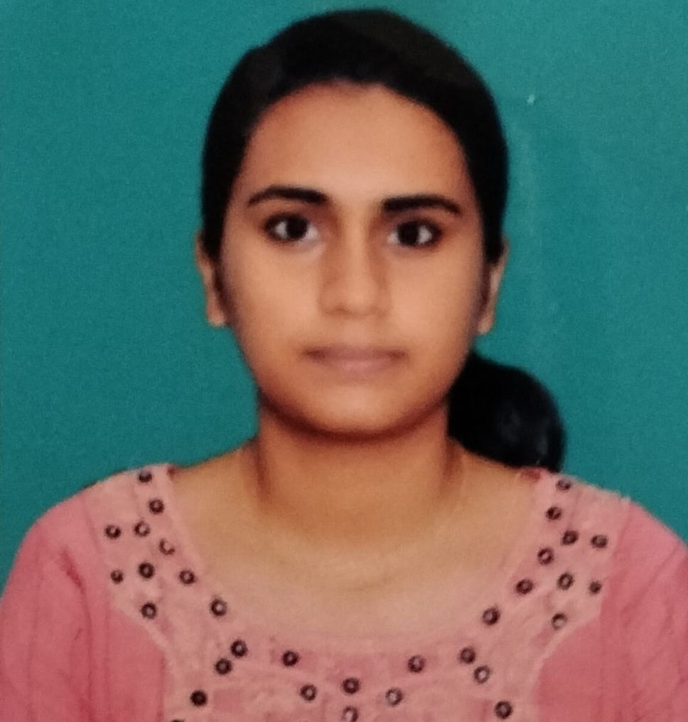



Namratha.k
Analyst/Software Engineer
Bachelor of Engineering
Computer Science : 2016 - 2020
Skills Java 8 /J2EE
Spring Boot
Spring MVC
MERN Stack
NodeJS
MongoDB
Database
SQL database – MySQL
No SQL database – MongoDB
Web Technologies
HTML5
CSS3
Javascript
AddOns
Github
Maven
Postman
Additional Details
Adaptable
Patience
Teamwork
Bangalore
Namratha.a.k@capgemini.com
7019852405
A4
Java Full Stack Developer
Has working knowledge on Angular and Java Microservice Development using Spring framework on an intermediate level.
Hands on experience in creating microservices with Spring Boot, Spring Security, Spring Cloud API Gateway, Eureka server.
Hands on experience in connecting mongoDB with Spring Boot and Angular.
https://github.com/Namratha246-k
E-Commerce Agriculture Crop System Application
Completed end to end case study of Agriculture Crop System Application along with JWT authentication, Swagger and payment testing using Braintree in MERN Stack. Material-UI and React Bootstrap used for user interface.
HTML CSS JAVASCRIPT for web developers at Coursera
Completed this course with 98.6% and Designed responsive Restaurant website using HTML5 CSS3 Bootstrap and Javascript
Check out my work on GitHub & Video Profile

